Slide 1
Genetic Algorithms
An AI Technique inspired by Biological Evolution

Slide 2
What is Genetic algorithm?
A genetic algorithm is an example of “evolutionary computation” computation algorithm inspired by biological evolution / natural selection used to solve tough computation problems.
Typically, Our Algorithm will be generating solutions to problems and We kind of apply this principle of ‘Survival of the fittest’ to generate better solution.
GA is regarded as a meta-heuristic optimization method and useful for finding good solutions for optimization / Constraint Satisfaction (maximization or minimization) problems . GA does not guarantee a global optimal or best solution.
Some Powerful “real-world” examples in a variety of areas include planning, scheduling, DNA Sequencing, computer graphics and natural language processing

Slide 3
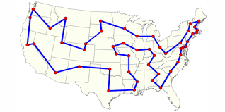
Case Study – Scheduling with ga
Case: Consider a delivery company, such as UPS, that plans and schedules delivery of consignments.
UPS has over 90,000 trucks to deliver orders. Every day, each truck starts at a depot, makes n stops to deliver the order, and returns to the depot, where 20<n<50
Suppose UPS could compute a matrix of costs of getting the truck between every pair of n stops, UPS would compute the best route with the lowest overall cost for this truck.
No. of Stops = 20 ; 20!= 2,432,902,008,177,000,000 routes (n!) to consider; UPS Evaluation rate = 1,000,000,000 orders / sec
Then it would take about 28 days to try all 20! permutations. Hence, brute force would not be feasible to solve this typical traveling-salesperson problem.
And that's for just one truck out of the 90,000+. Even if UPS could make their routes just 1% more efficient, the overall savings would scale up significantly.

Slide 4
How do we make one?

Slide 5
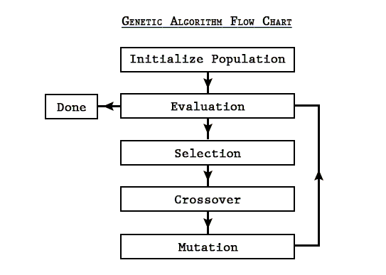
We need a few things
A Problem to Solve , We have Traveling Sales Man Problem in hand
A fitness function - A method to evaluate the solution that is generated by the our algorithm. In this case, Shorter the Distance covered by the truck, the better
A way to represent the solution as ‘DNA’ - An Ordered Collection of Cities. City[0]= City A, City[1]=City B, City[2]=City C etc.

Slide 6
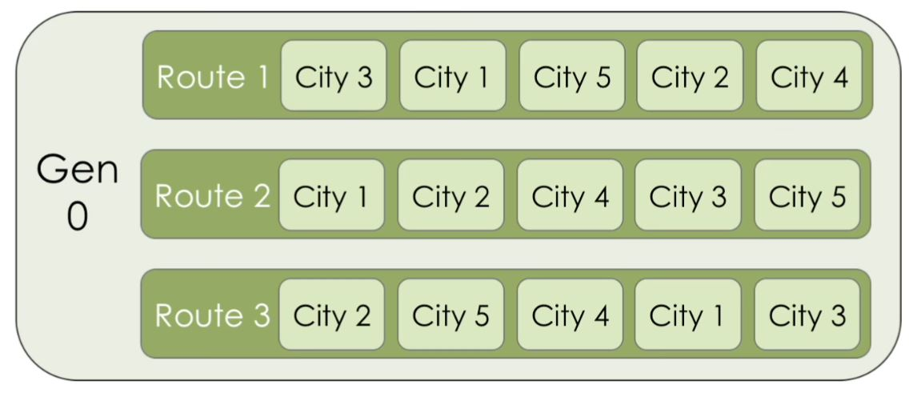
Step 1 – Selection
With the given cities, randomly generate a ‘population’ (Diversity of Different Solutions / Routes) of possible routes (50 different solutions)
Calculate fitness of each route (1 / total distance)
select top n (2) shortest routes based on our fitness function for cross over

Slide 7
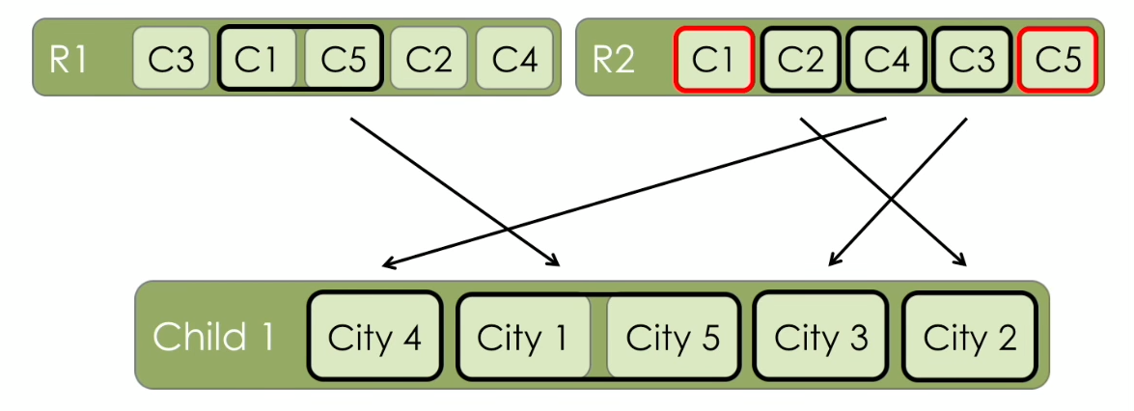
Step 2– Cross over
Formally cross over. Our routes are ordered. Our crossover step must therefore pass ordered segments to children.

Slide 8

Step 3 – mutation
Randomly Mutate each child route (Change the Sequence)
Add Children to Next Generation of Solution.
Rinse and Repeat Steps 1, 2 ,3 until the solution generates fitter and better solution

Slide 9
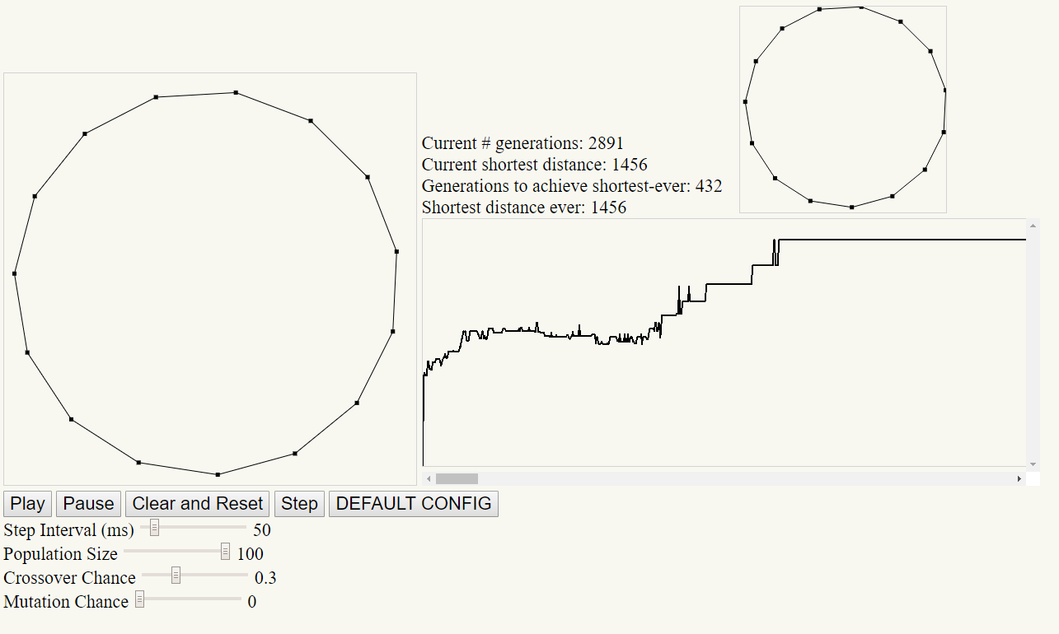
Demo time
Population=10, cross=.3, mutation=0 => Low diversity, local max problem, bad solver
Population=100, cross=.3, mutation=100 => Terrible solver
Population=100, cross=.3, mutation=0 => very nice solver
Therefore, We can compute the best route faster and optimize the delivery routes – which can be a huge cost savings and value-add in terms or resource utilization to the company.
TSP Implementation Credits: https://github.com/ptrkkim/Genetic-Algo-Tech-Talk

Slide 10
Thank you

